Slide 1

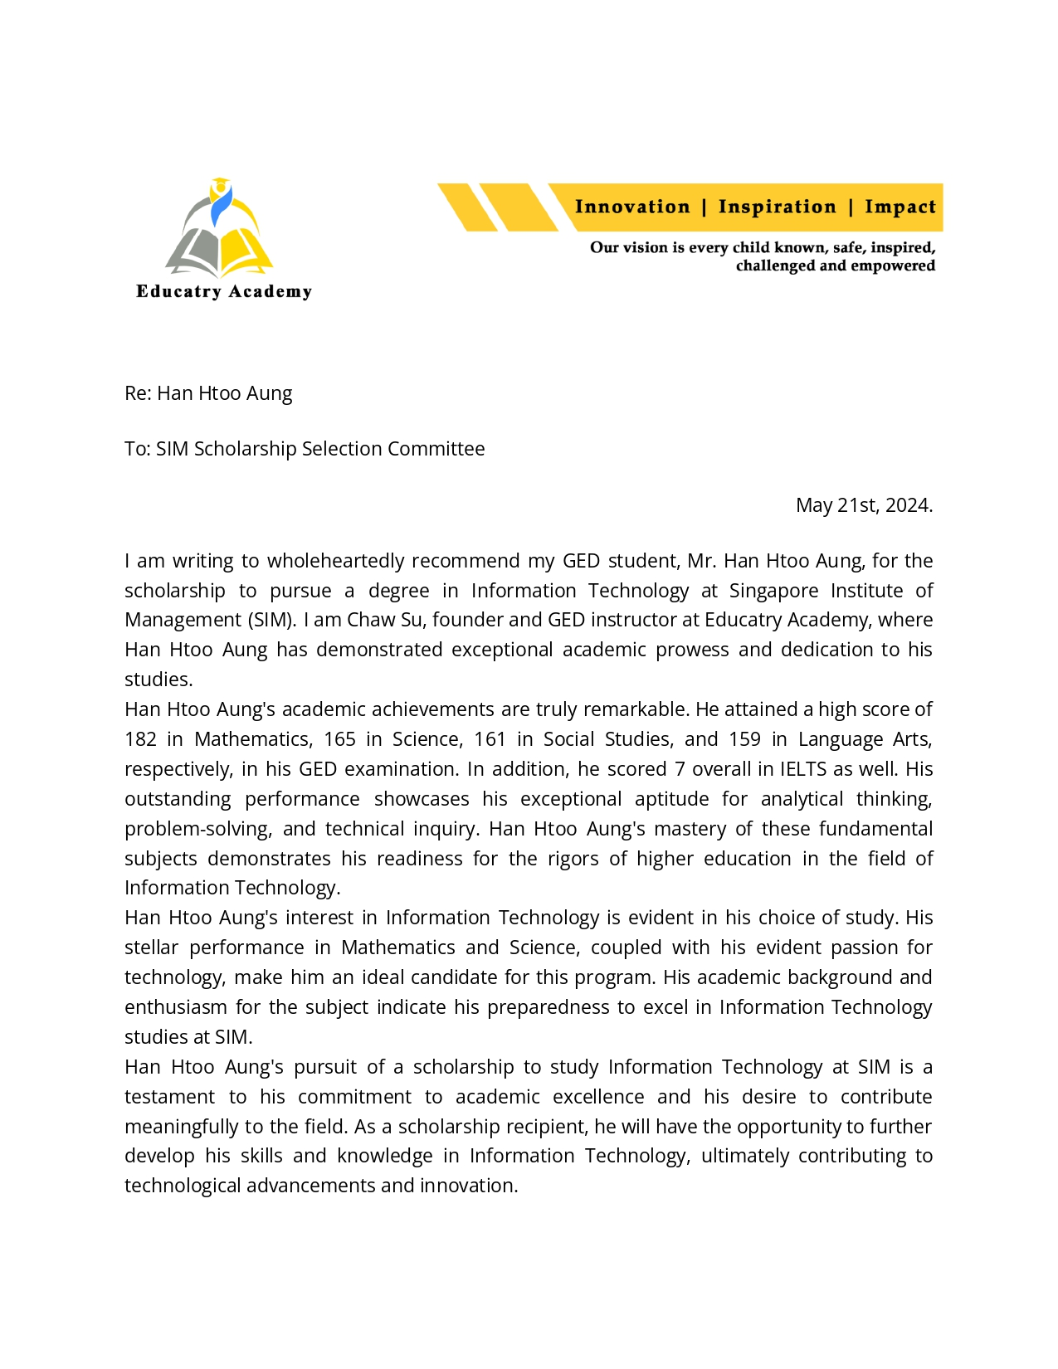
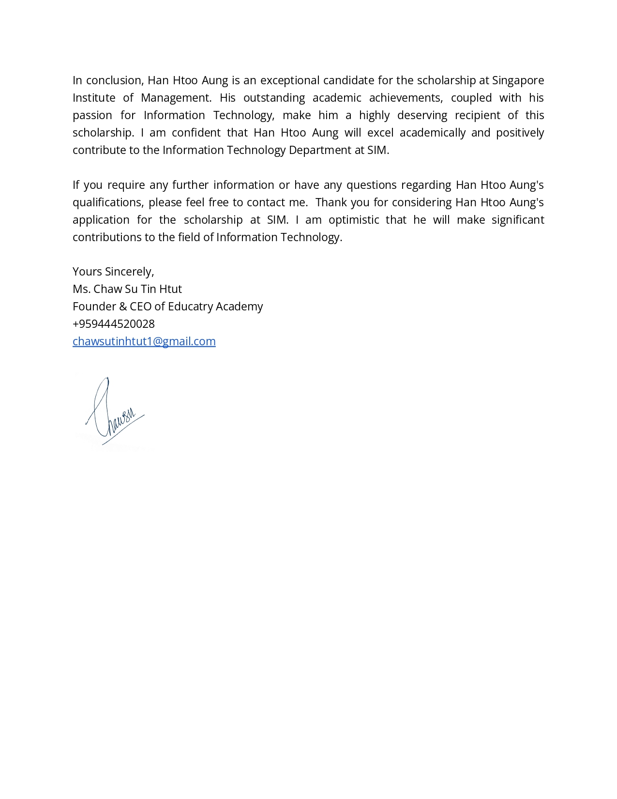
Recommendation letter (Educatory Academy)

Slide 2

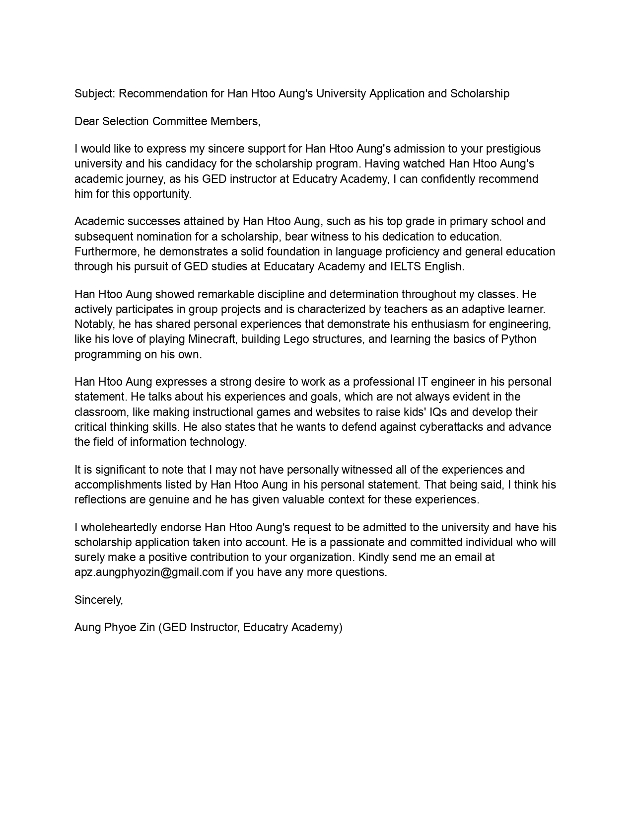
Recommendation letter from Tr. Aung Phyo Zin (GED instructor)

Slide 3

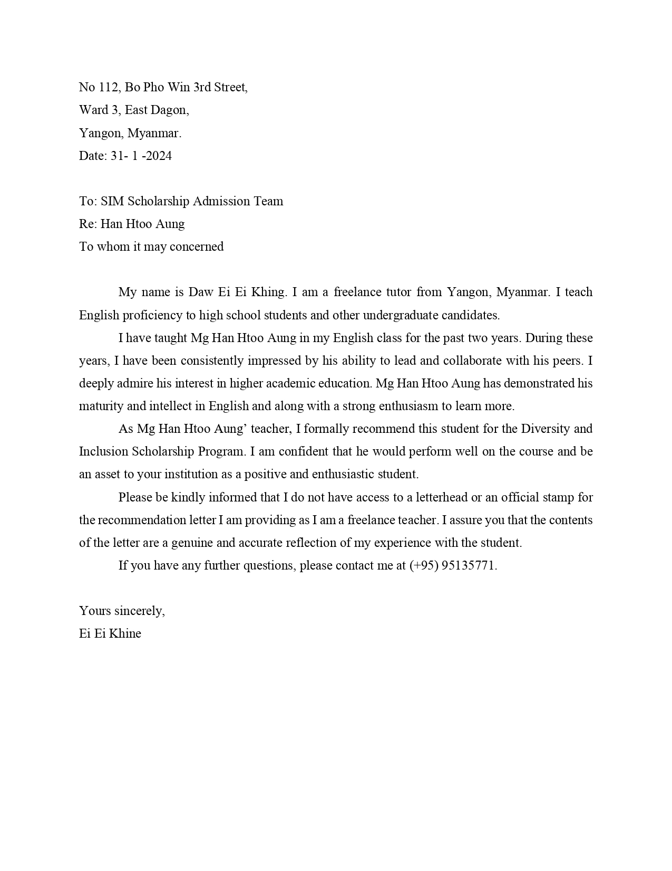
Slide title 29
Recommendation letter from Tr. Ei Ei Khaing (English instructor)

Slide 4

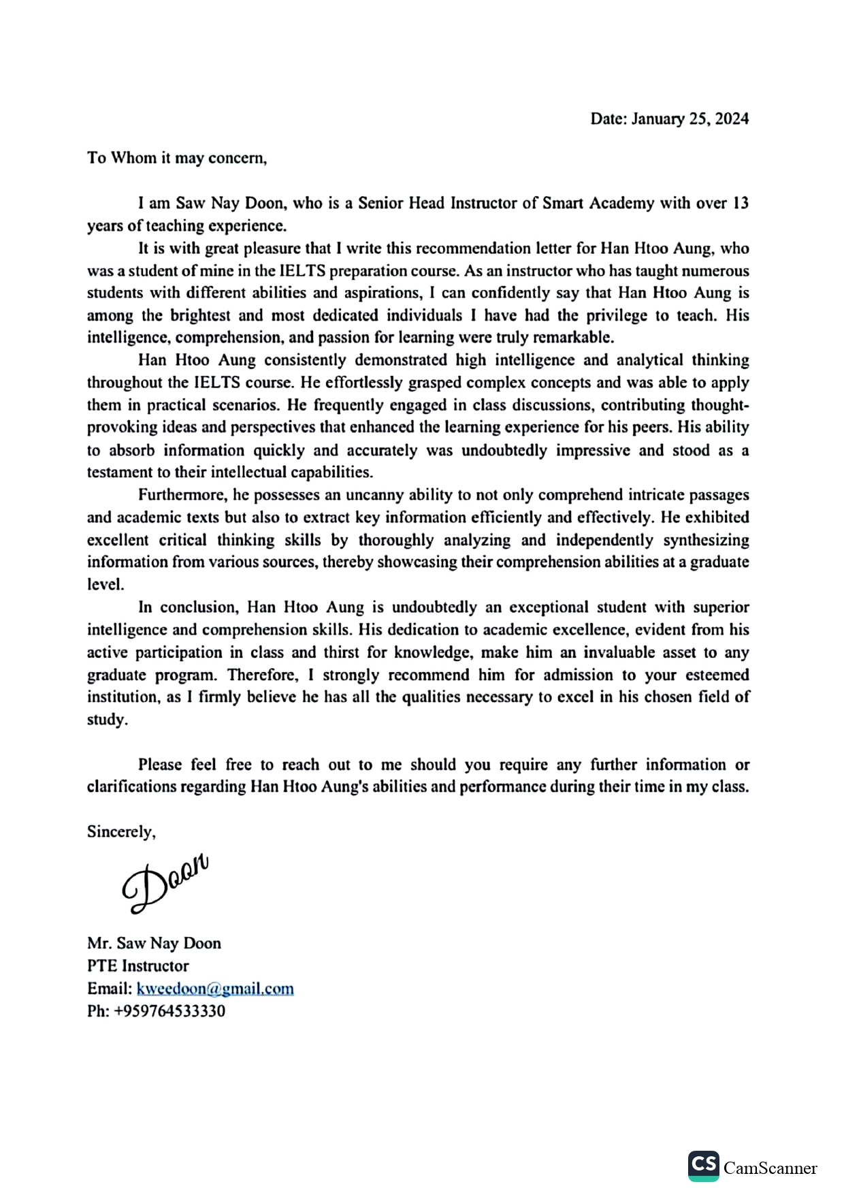
Recommendation letter from Tr. Saw Nay Doon (IELTS instructor from Smart Academy)

